Slide 1

4G LOCALIZATION IN TELECOM
NEURAL NETWORKS PROJECT MEETING 3 (17.5.2020)

Slide 2
TEAM MEMBERS
A
Amel Mohamed Mahmoud
M
Mohamed Magdy El-Sayed
M
Mohamed Tharwat Waheed
T
Tarek AbuBakr AbduElAziz
Notes:
© Copyright PresentationGo.com – The free PowerPoint library

Slide 3








Infographic Matrix (Folder) – Slide Template
Agenda
Our 1st Model
Last meeting actions
Presents our 1st NN model going through its iterations using different data features
Working on last meeting’s comments and requested actions
4G localization
Way forward
Literature review for all previous works in 4G localization focusing on new trending algorithms
What’s next?
Notes:
© Copyright PresentationGO.com – The free PowerPoint template library

Slide 4
Infographic Matrix (Folder) – Slide Template
Agenda
Last meeting actions
Our 1st Model
Presents our 1st NN model going through its iterations using different data features
Working on last meeting’s comments and requested actions
4G localization
Way forward
Literature review for all previous works in 4G localization focusing on new trending algorithms
What’s next?
Notes:
© Copyright PresentationGO.com – The free PowerPoint template library

Slide 5
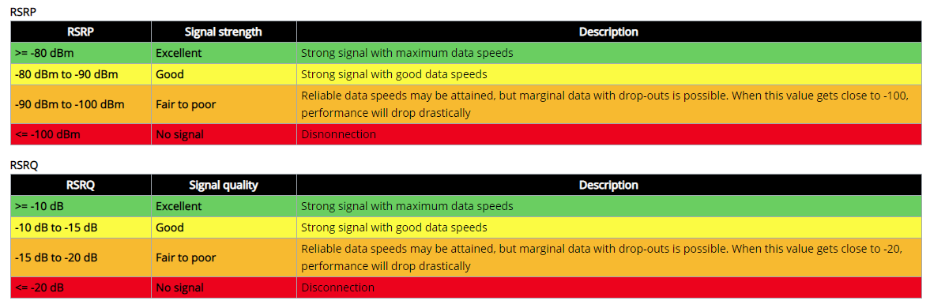
FEATURES ABBREVIATIONS
Main serving and neighboring RSRP/RSRQ
RSRP: Reference Signal Receive Power that is the average received power.
RSRQ: Reference Signal Receive Quality that is considering also RSSI.
https://wiki.teltonika-networks.com/view/RSRP_and_RSRQ

Slide 6
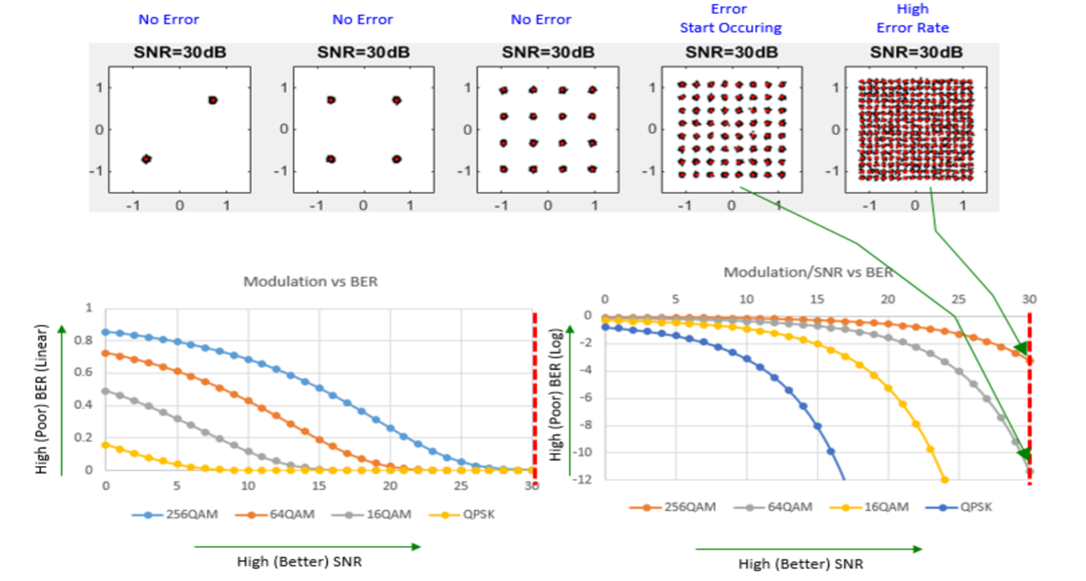
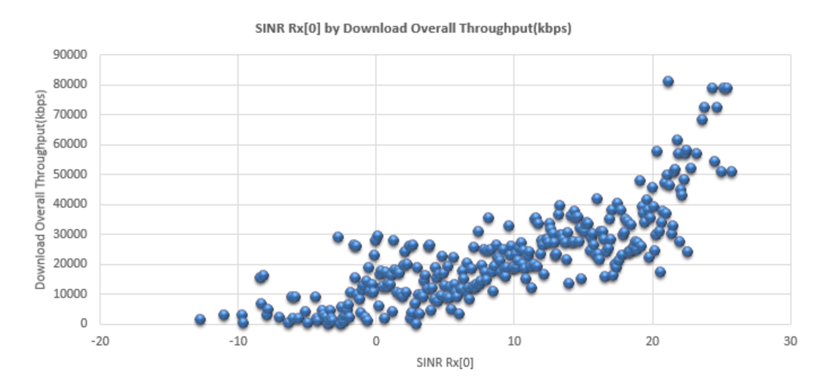
FEATURES ABBREVIATIONS
SINR: Signal to Interference & Noise Ratio, it is also indicator for network quality.
Higher SNR means better modulation and higher data throughput or voice quality
https://www.sharetechnote.com/html/RF_Handbook_SNR.html

Slide 7
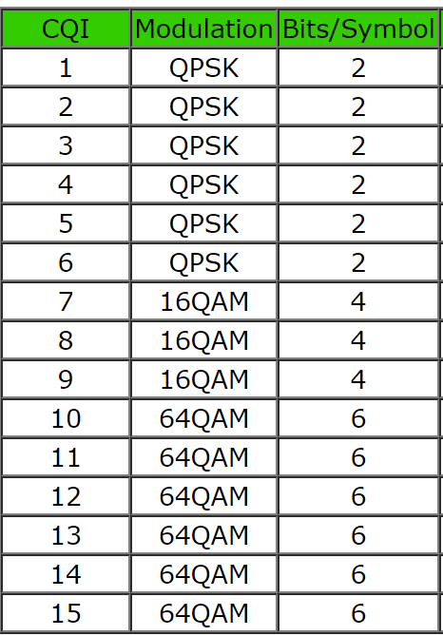
FEATURES ABBREVIATIONS
CQI: stands for Channel Quality Indicator. As the name implies, it is an indicator carrying the information on how good/bad the communication channel quality is.
PCI and TAC
PCI: Physical Cell ID which is one of the most important cell identifier in the wireless network of LTE system.
TAC: Tracking Area Code which identifies a tracking area within a particular network.
https://www.sharetechnote.com/html/Handbook_LTE_CQI.html
https://www.sharetechnote.com/html/Handbook_LTE_PCI.html
https://www.sharetechnote.com/html/Handbook_LTE_Tracking_Area.html
http://4g5gworld.com/blog/timing-advance-ta-lte

Slide 8
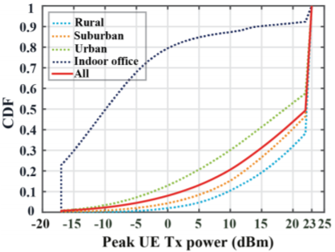
FEATURES ABBREVIATIONS
UE TX POWER: The UE power described in dBm and it rnages from -20 to 23 dBm. UE increases its transmit power to fully compensate any increase in path loss. Area topology impacts UE Tx power where rural areas implies higher power compared to indoor environment.
(Downlink/Uplink) Frequency Band and Bandwidth
Frequency used in DL and UL direction
DL bandwidth differs than UL bandwidth due to difference in CA (carrier aggregation) and
https://ieeexplore.ieee.org/stamp/stamp.jsp?arnumber=7879218
http://www.sharetechnote.com/html/Handbook_LTE_Band_ChannelBandwidth.html

Slide 9
Agenda
Last meeting actions
Our 1st Model
Presents our 1st NN model going through its iterations using different data features
Working on last meeting’s comments and requested actions
4G localization
Way forward
Literature review for all previous works in 4G localization focusing on new trending algorithms
What’s next?
Notes:
© Copyright PresentationGO.com – The free PowerPoint template library

Slide 10
1- LTE Location Based Services (LCS) “ 3GPP Release 9”
01
Satellite Based Positioning: Autonomous and Assisted Global Navigation Satellite Systems (A-GNSS) such as GPS and GLONASS
02
Mobile Radio Cellular Positioning: Observed Time Difference of Arrival (OTDOA) and enhanced Cell ID (eCID)
LPP SUPL2.0
03
Hybrid Methods: Hybrid-GNSS or GNSS + Mobile Radio Cellular Positioning like OTDOA
Hybrid
Mobile Radio
04
Control/User Plane (C-Plane | U-Plane) session handling: LPP, SUPL 2.0
Satellite
https://cdn.rohde-schwarz.com/pws/dl_downloads/dl_common_library/dl_brochures_and_datasheets/pdf_1/LTE_LBS_White_Paper.pdf

Slide 11
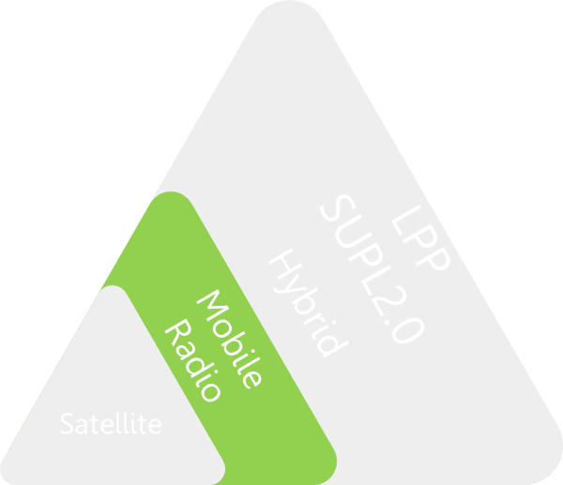
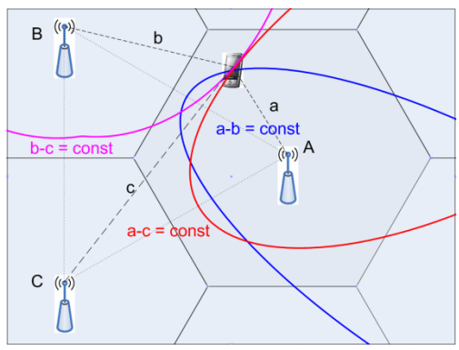
1- LTE Location Based Services (LCS) “ 3GPP Release 9”
02
Mobile Radio Cellular Positioning:
OTDOA – Observed Time Difference of Arrival
OTDOA uses neighbor cells (eNB’s) to derive an OTDOA relative to the serving cell.
The measurement needs to be taken at least for 3 pairs of base station.
The position of the device is the intersection of the three hyperbolas.
TDOA measurement based on hyperbolas
https://cdn.rohde-schwarz.com/pws/dl_downloads/dl_common_library/dl_brochures_and_datasheets/pdf_1/LTE_LBS_White_Paper.pdf

Slide 12
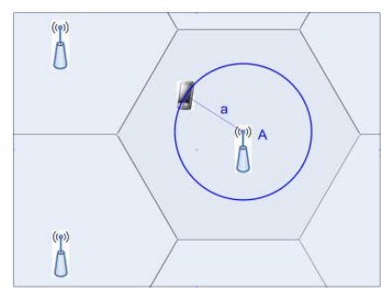
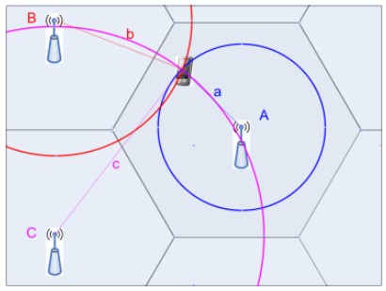
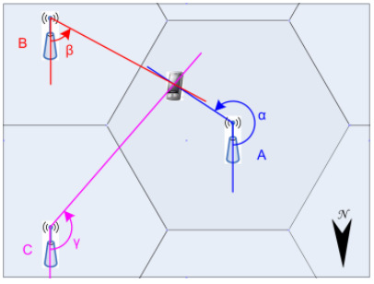
1- LTE Location Based Services (LCS) “ 3GPP Release 9”
02
Mobile Radio Cellular Positioning:
eCID – Enhanced Cell ID
It is another method for position estimation in LTE.
First Way: E-CID with estimating distance from 1 BS.
Second Way: E-CID with measuring distance from 3 BSs.
Third Way: E-CID with measuring the Angle-of-Arrival (AoA) from at least 2 BS.
https://cdn.rohde-schwarz.com/pws/dl_downloads/dl_common_library/dl_brochures_and_datasheets/pdf_1/LTE_LBS_White_Paper.pdf

Slide 13
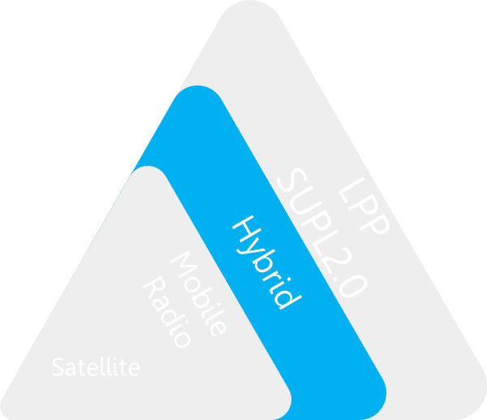
1- LTE Location Based Services (LCS) “ 3GPP Release 9”
03
Hybrid Methods:
Hybrid-GNSS + OTDOA
Hybrid positioning combines TDOA measurements (obtained from the LTE network) with GNSS measurements.
Hybrid method improves positioning availability and accuracy, particularly in environments where GNSS signal reception might be impaired.
https://cdn.rohde-schwarz.com/pws/dl_downloads/dl_common_library/dl_brochures_and_datasheets/pdf_1/LTE_LBS_White_Paper.pdf

Slide 14
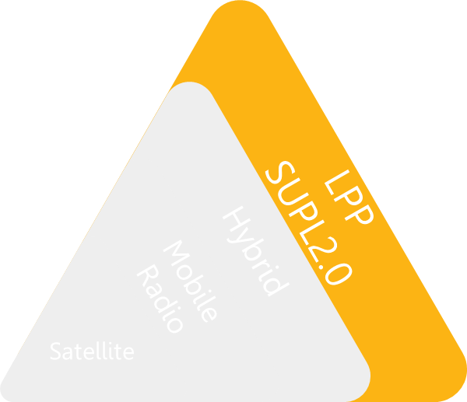
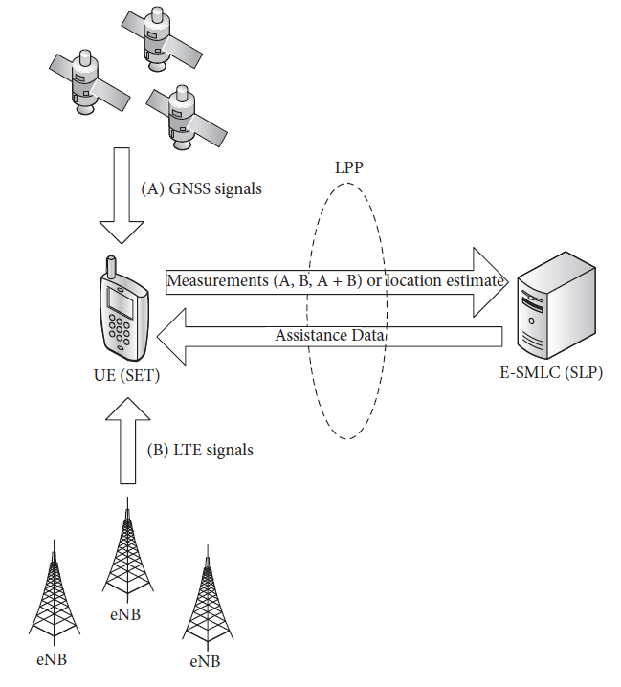
1- LTE Location Based Services (LCS) “ 3GPP Release 9”
04
Control/User Plane (C-Plane | U-Plane) session handling:
LPP
E-SMLC | Evolved Serving Mobile Location Center
UE-based positioning: UE sends its location estimate to the E-SMLC.
UE-assisted positioning: UE sends measurements (from GNSS, from LTE network, or form both in the case of hybrid).
https://cdn.rohde-schwarz.com/pws/dl_downloads/dl_common_library/dl_brochures_and_datasheets/pdf_1/LTE_LBS_White_Paper.pdf

Slide 15
(B)
Recent Advances in Indoor Localization: A Survey

Slide 16
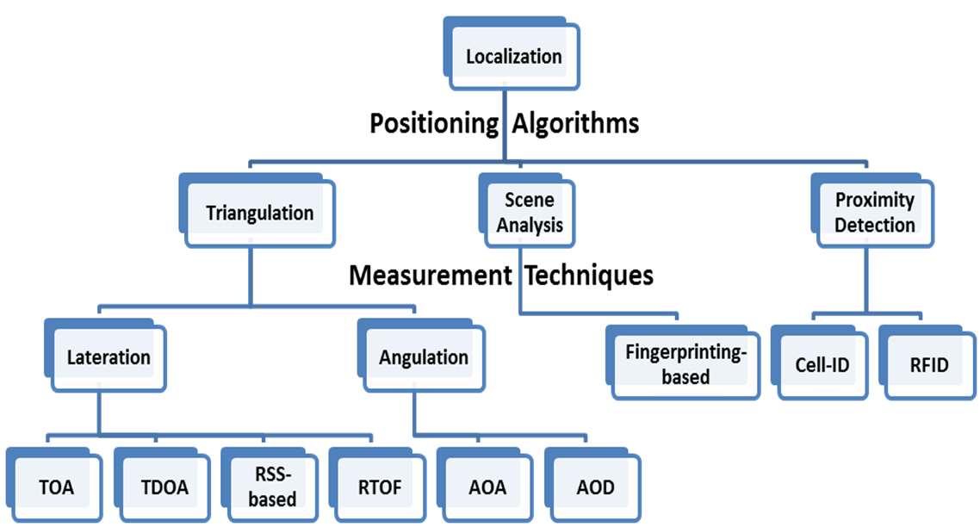
(B) Recent Advances in Indoor Localization: A Survey
TOA | Time of Arrival
TDOA | Time Difference of Arrival
RSS-based | Received Signal Strength-based
RTOF | Round-trip Time-of-flight
AOA | Angle of Arrival
AOD | Angle of Departure
RFID | Radio Frequency Identification
https://ieeexplore.ieee.org/document/7762095

Slide 17
(C)
Experimental Study of Telco Localization Methods
“2017”

Slide 18
(C) Experimental Study of Telco Localization Methods
Outdoor Localization.
This paper studies the performance of five algorithms:
RSS-based algorithm.
Fingerprinting algorithm-Cellsense.
Machine learning based algorithm (Random Forest).
Machine learning based algorithm (Multilayer perceptron neural network).
Machine learning based algorithm (XGBoost).
https://www.researchgate.net/publication/318126815_Experimental_Study_of_Telco_Localization_Methods

Slide 19
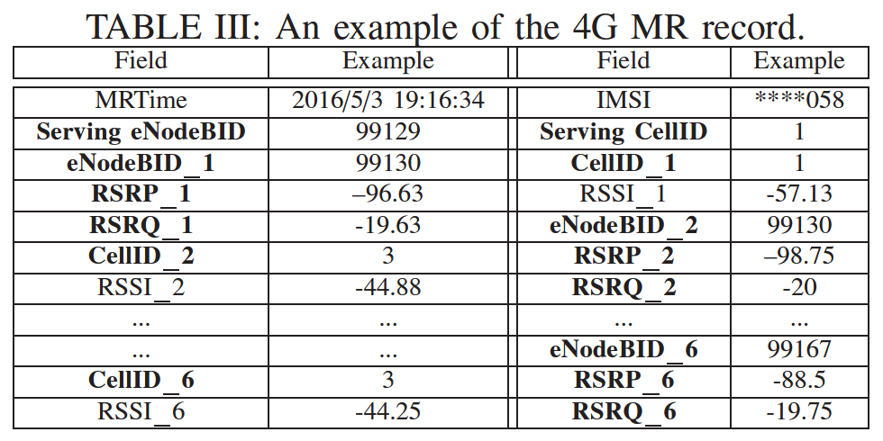
(C) Experimental Study of Telco Localization Methods
MR | Measurement Report.
eNodeBID | BS is uniquely identified by this number.
RSSI | Received Signal Strength Indicator, it helps determining interference and noise information.
RSRP | Reference Signal received power, it provides information about signal strength.
RSRQ | Reference Signal received quality.
MR record contains items from 6 nearby sectors.
Example of 4G MR.

Slide 20
(C) Experimental Study of Telco Localization Methods
Maximum Likelihood Estimator (RSS Based)
The positions of unknown-location sensors are estimated from the known location sensors.
It is a measurement-based method which outperforms other linear estimators.
The position of an Mobile Device (MD) can be calculated from RSSIs under a function of signal propagation power.
(2) Cellsense
It is a fingerprinting method for Telco localization.
It divides the urban areas into small grids.
Each grid is represented by a fingerprint consisting of the RSSI of each BS from the MDs within this grid (from the training data).

Slide 21
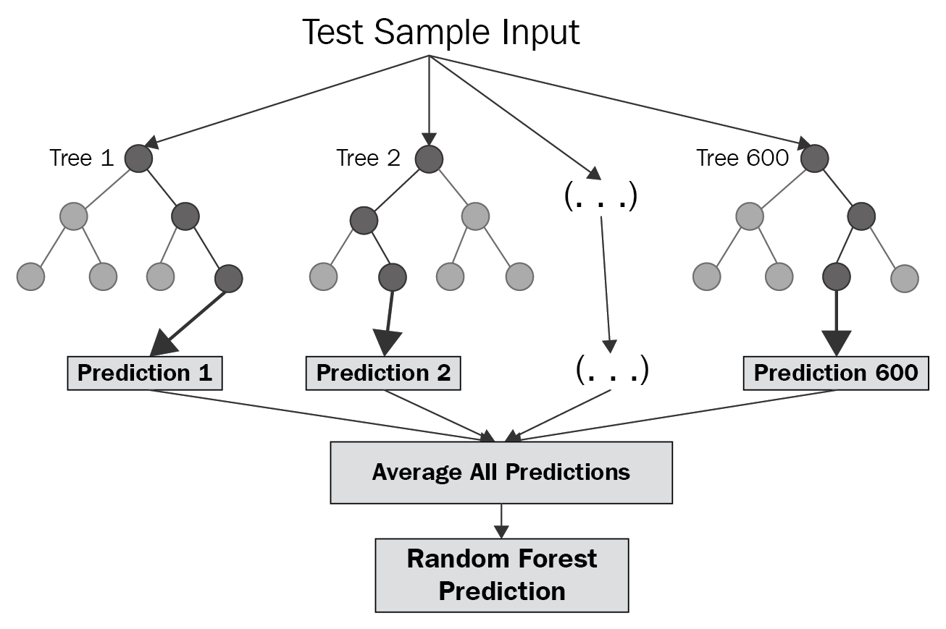
(C) Experimental Study of Telco Localization Methods
(3) Random Forest (RF)
At training time, it constructs “Decision trees”.
It predicts the location by using a machine learning (ML) model.
It makes use of the signal measurements in MR data as features and the position point or position grid as label to train the ML model.
https://towardsdatascience.com/random-forest-and-its-implementation-71824ced454f

Slide 22
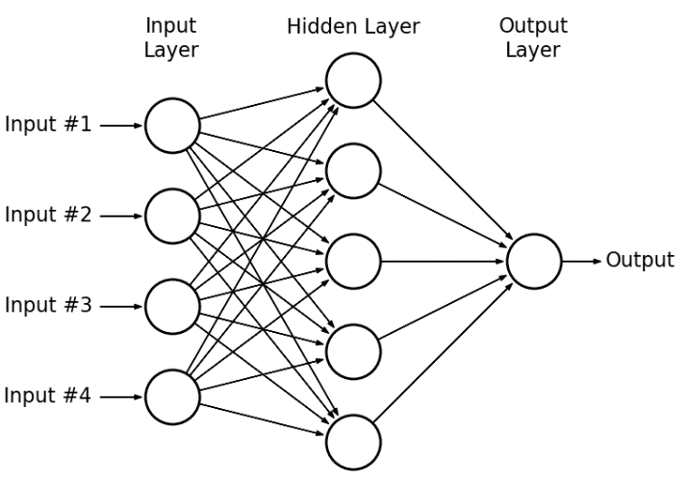
(C) Experimental Study of Telco Localization Methods
(4) Multi-Layer Perceptron (MLP)
It is a feed forward network.
This paper adopts a three-layer network.
Input: vector of variable values of MR data.
Output: probabilities of each grid.
(5) XGBoost (eXtreme Gradient Boosting)
It is open-source software library which provides a gradient boosting framework for different programming languages.
It implements multiple parallel machine learning algorithms, thus it is very fast.

Slide 23
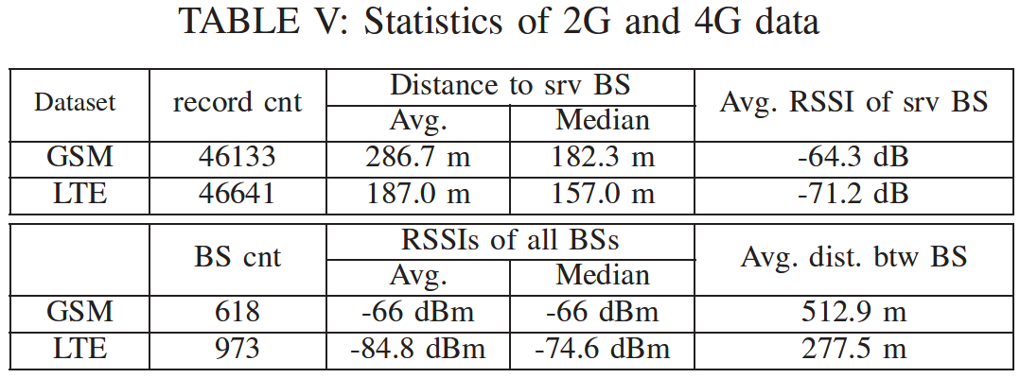
Data Sets
Real MR datasets covering a 2 Km × 4 Km urban area from 2G (GSM) and 4G (LTE) networks.
From Table:
4G BSs are much denser than 2G BSs.
RSSI of 4G BS is weaker than 2G (the smaller the RSSI value, the better the signal quality).
In 4G, no need for MD to measure many neighbors because of the high density of BSs.

Slide 24
(C) Experimental Study of Telco Localization Methods
Results
Accuracy: RF achieves the minimum error. Then MLP, Cellsense, and XGboost. ML is the worst.
Data Volume: More training data benefits better performance of the algorithms.
Neighbors: The better localization performance on 4G data mainly benefits from more neighbor BSs.
Gridding: It leads to better localization. However, increasing the grid size is decreasing the accuracy.
Time Consuming: The training time of MLP and XGBoost dominates the overall time (many iterations).
Time with different Grid Sizes: Larger grid size results in faster running time.

Slide 25
(D)
Neural-Network-Assisted UE Localization Using Radio-Channel Fingerprints
in LTE Networks

Slide 26
(D) NN-Assisted UE Localization in LTE Networks
Introduction
This technique utilizes a unique mapping between the characteristics of a radio channel formulated as a fingerprint vector and a geographical location.
A feature-extraction algorithm is applied to select channel parameters with non-redundant information that are calculated from the LTE downlink signals.
The fingerprint can be composed of the channel parameters calculated from:
CIR profiles (CHANNEL-IMPULSE-RESPONSE): The UE receives radio signals from the BS in service, and CIRs are extracted from common pilot signals.
MPCs (Multipath Components).

Slide 27
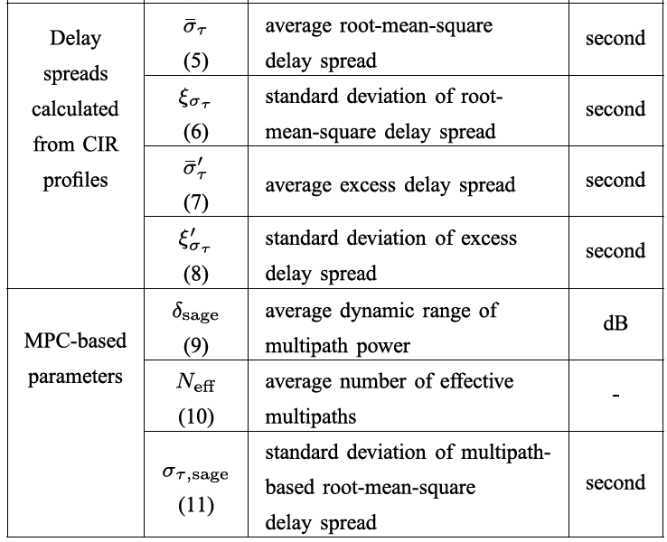
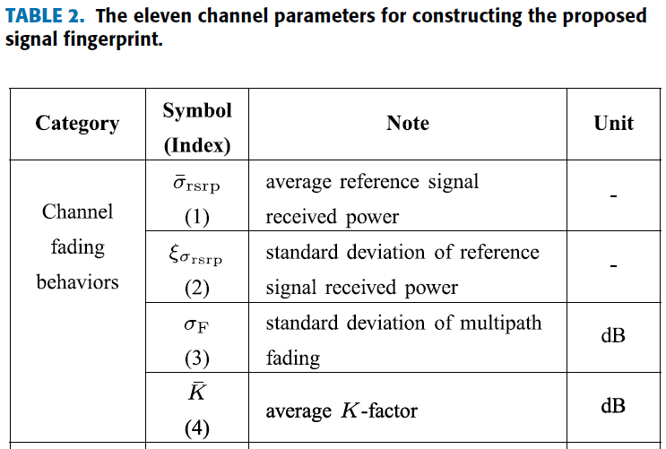
(D) NN-Assisted UE Localization in LTE Networks
Features

Slide 28
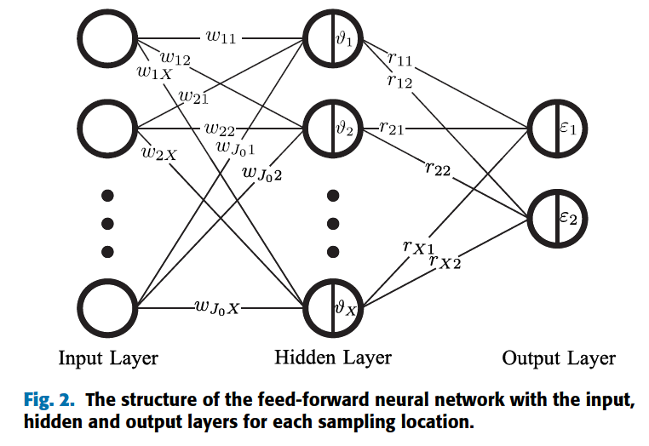
(D) NN-Assisted UE Localization in LTE Networks
Model
A feed forward neural network is used.
Input: fingerprint vectors (fingerprint matrix).
Output: Estimated UEs positions (Location Matrix).
Three layers (input layer, hidden layer, output layer).
Input-layer-neuron represents a selected channel parameter after feature-extraction.
There are 2 output-layer-neurons denote the two components of the location coordinate.

Slide 29
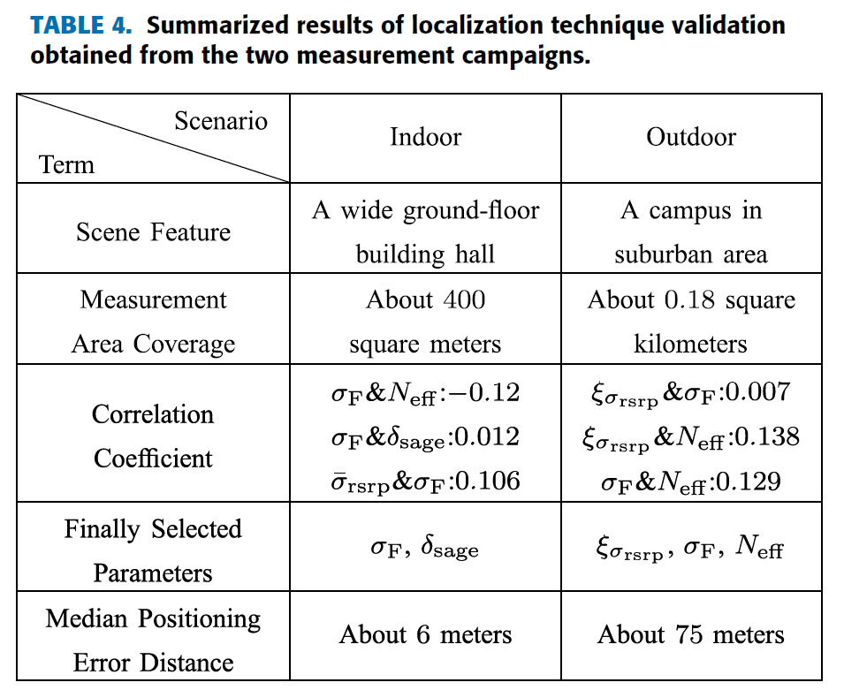
(D) NN-Assisted UE Localization in LTE Networks
Results

Slide 30
(E)
Deep Neural Network-based Telco Outdoor Localization

Slide 31
(E) RecuLSTM
Introduction
RecuLSTM is a deep neural network based localization approach that automatically extracts contextual features and predicts the positions of mobile devices from an input sequence of Measurements Record (MR) data.
RecuLSTM is a recursive neural networks structure depends on long short term memory networks (LSTM).
RecuLSTM can
1) Automatically extract contextual features from input sequence of MR records.
2) Use the extracted features to predict the GPS coordinates by a regression model.

Slide 32
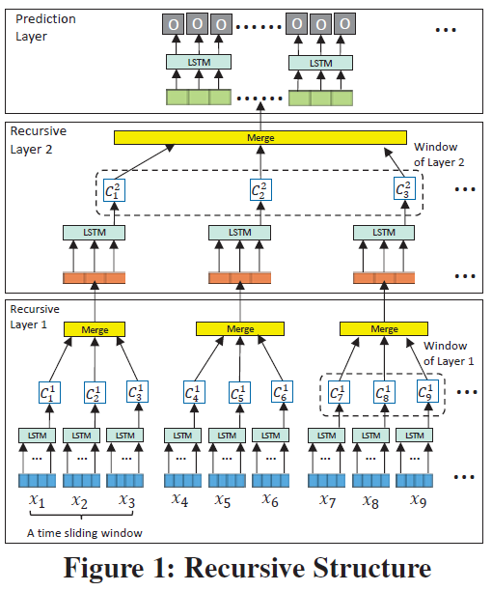
(E) RecuLSTM
Recursive Structure
RecuLSTM consists of two parts:
1) Multiple recursive layers to extract features.
2) One prediction layer.
The first recursive layer extracts (local) features from an input MR record, then merges those features to have a new output.
Those merged outputs are the short-term memory features which are recursively used as the input of next recursive layers. Thus, we generate long-term memory contextual features (global features).

Slide 33
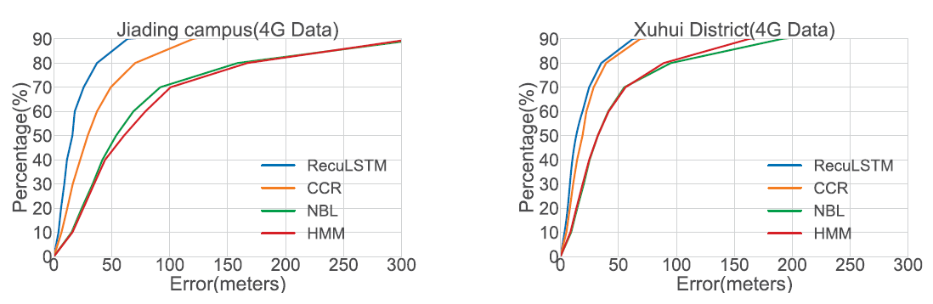
(E) RecuLSTM
Results
RecuLSTM greatly outperforms 3 state-of-the-art approaches.

Slide 34
Infographic Matrix (Folder) – Slide Template
Agenda
Our 1st Model
Last meeting actions
Presents our 1st NN model going through its iterations using different data features
Working on last meeting’s comments and requested actions
4G localization
Way forward
Literature review for all previous works in 4G localization focusing on new trending algorithms
What’s next?
Notes:
© Copyright PresentationGO.com – The free PowerPoint template library

Slide 35

Our Research
Verify
Verify existing models using large data samples
Heterogeneity
using same mobile but different operators, Or different mobiles but same operator.
4G Technology
Focus on 4G technology due to lack of research in this area
Model
Optimize model hyper-parameters based on all above new research areas
New Features
Addressing new 4G data features that impact localization problem

Slide 36
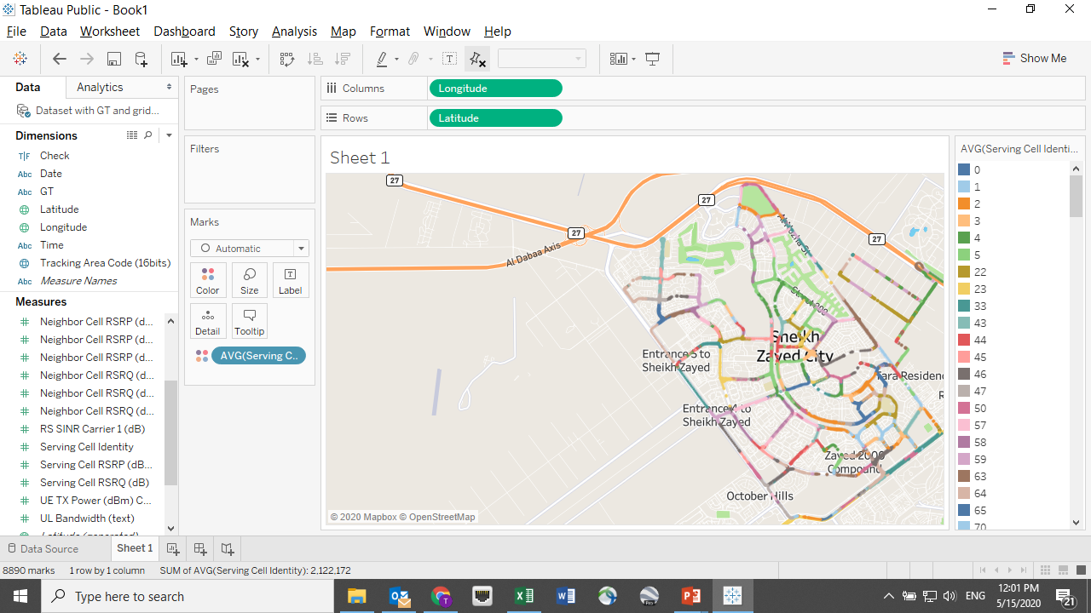
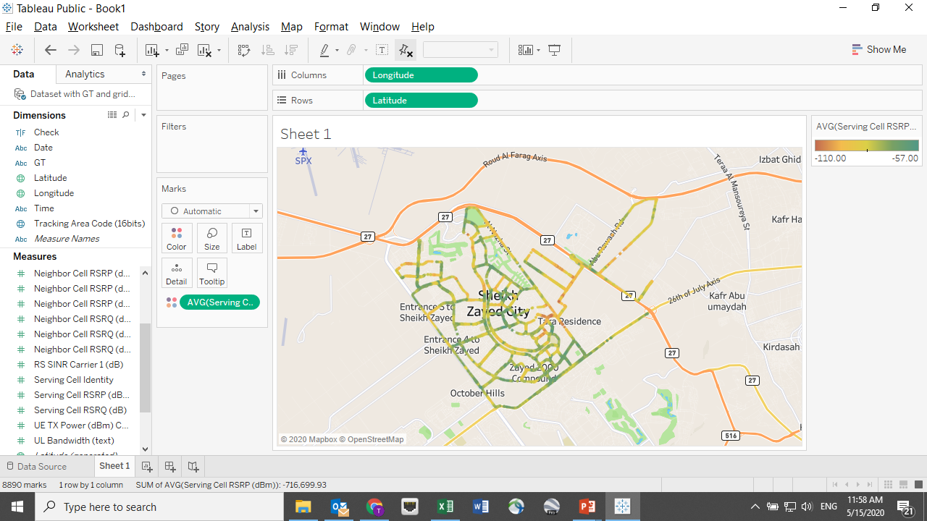
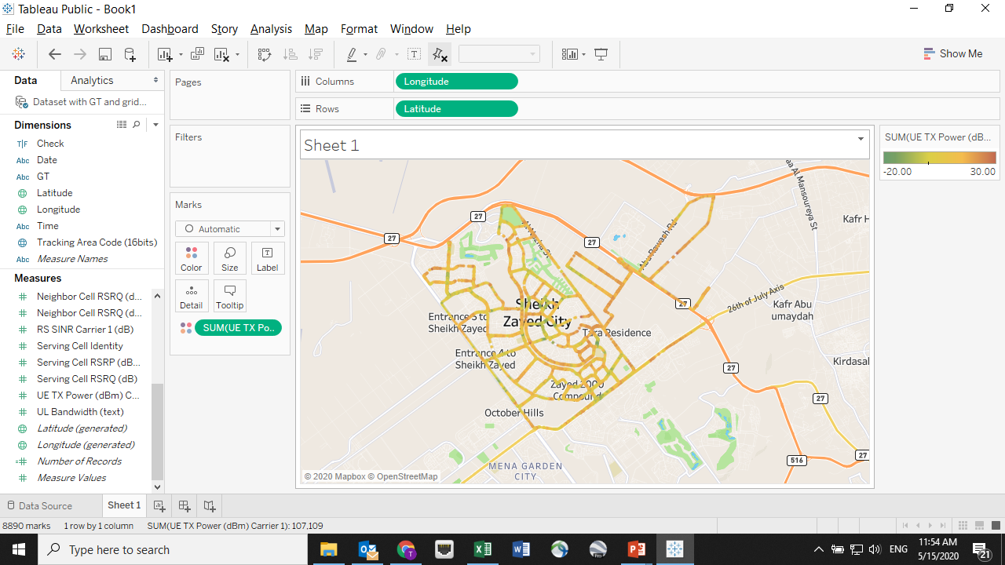

Area Selection | Shiekh Zayed | Sub-Urban Area

Slide 37
Infographic Matrix (Folder) – Slide Template
Agenda
Last meeting actions
Our 1st Model
Presents our 1st NN model going through its iterations using different data features
Working on last meeting’s comments and requested actions
4G localization
Way forward
Literature review for all previous works in 4G localization focusing on new trending algorithms
What’s next?
Notes:
© Copyright PresentationGO.com – The free PowerPoint template library

Slide 38
Way Forward
Loc. Paper
Data Sample
Model Accuracy
Heterogeneity
Area size
Distance calc.
Cell ID number
Features analysis
Data augemnation
Areas selection
Hyper parameters OPT.
Grid size impact
Models BM
Different operators
Different Areas

